Slide 1
Tipe data, Operasi & Operator
Algoritma & Pemrograman #3
Sufajar Butsianto, M.Kom
Rev.00
Notes:
This template can be used as a starter file for presenting training materials in a group setting.
Sections
Right-click on a slide to add sections. Sections can help to organize your slides or facilitate collaboration between multiple authors.
Notes
Use the Notes section for delivery notes or to provide additional details for the audience. View these notes in Presentation View during your presentation.
Keep in mind the font size (important for accessibility, visibility, videotaping, and online production)
Coordinated colors
Pay particular attention to the graphs, charts, and text boxes.
Consider that attendees will print in black and white or grayscale. Run a test print to make sure your colors work when printed in pure black and white and grayscale.
Graphics, tables, and graphs
Keep it simple: If possible, use consistent, non-distracting styles and colors.
Label all graphs and tables.

Slide 2
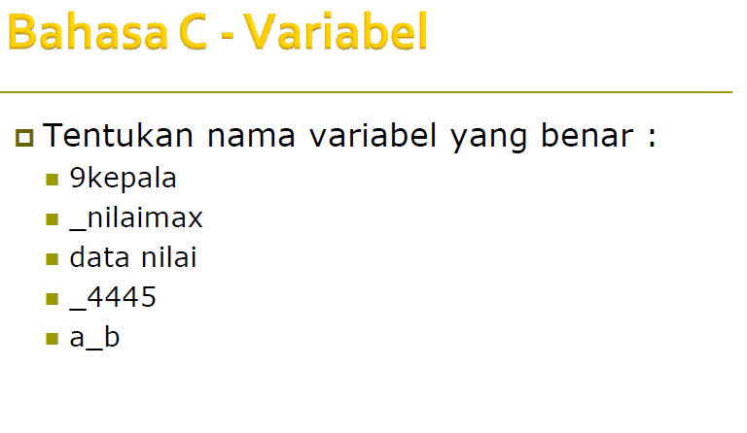
Notes:
Give a brief overview of the presentation. Describe the major focus of the presentation and why it is important.
Introduce each of the major topics.
To provide a road map for the audience, you can repeat this Overview slide throughout the presentation, highlighting the particular topic you will discuss next.

Slide 3
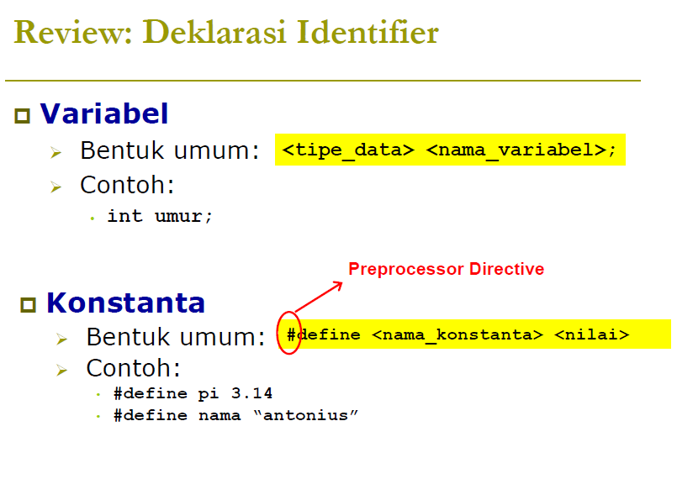
Notes:
Give a brief overview of the presentation. Describe the major focus of the presentation and why it is important.
Introduce each of the major topics.
To provide a road map for the audience, you can repeat this Overview slide throughout the presentation, highlighting the particular topic you will discuss next.

Slide 4
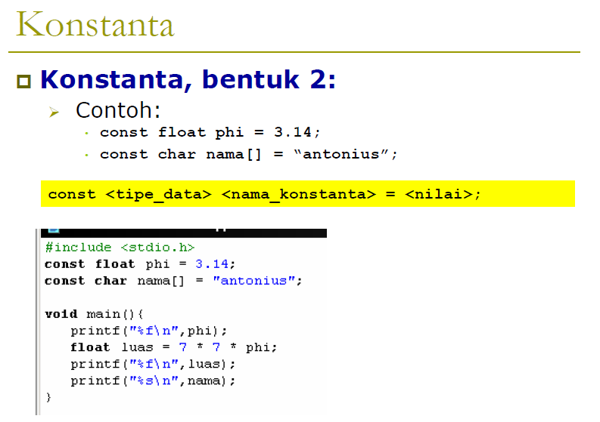
Notes:
Give a brief overview of the presentation. Describe the major focus of the presentation and why it is important.
Introduce each of the major topics.
To provide a road map for the audience, you can repeat this Overview slide throughout the presentation, highlighting the particular topic you will discuss next.

Slide 5
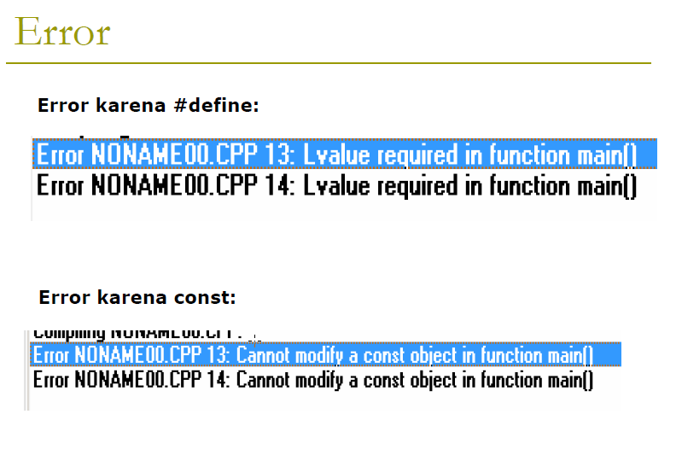
Notes:
Give a brief overview of the presentation. Describe the major focus of the presentation and why it is important.
Introduce each of the major topics.
To provide a road map for the audience, you can repeat this Overview slide throughout the presentation, highlighting the particular topic you will discuss next.

Slide 6
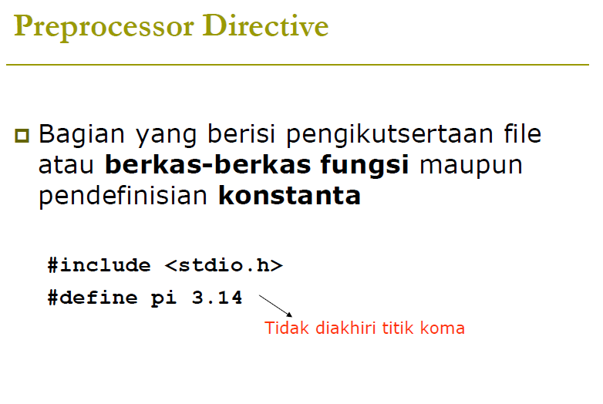
Notes:
Give a brief overview of the presentation. Describe the major focus of the presentation and why it is important.
Introduce each of the major topics.
To provide a road map for the audience, you can repeat this Overview slide throughout the presentation, highlighting the particular topic you will discuss next.

Slide 7
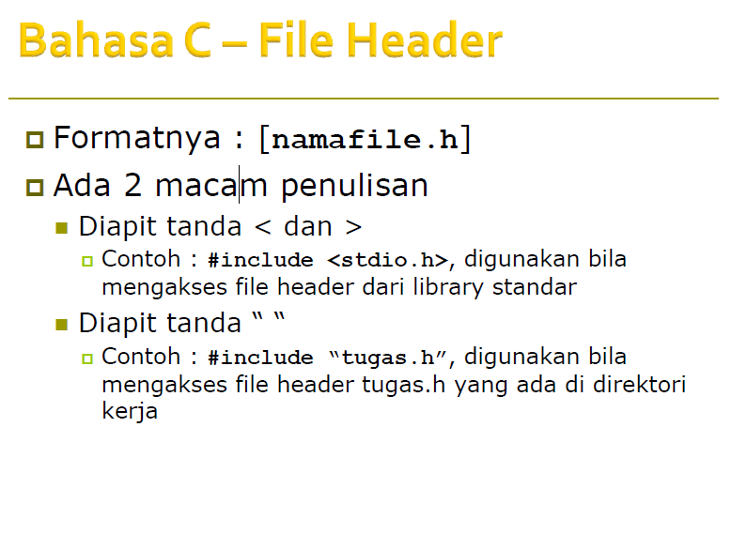
Notes:
Give a brief overview of the presentation. Describe the major focus of the presentation and why it is important.
Introduce each of the major topics.
To provide a road map for the audience, you can repeat this Overview slide throughout the presentation, highlighting the particular topic you will discuss next.

Slide 8
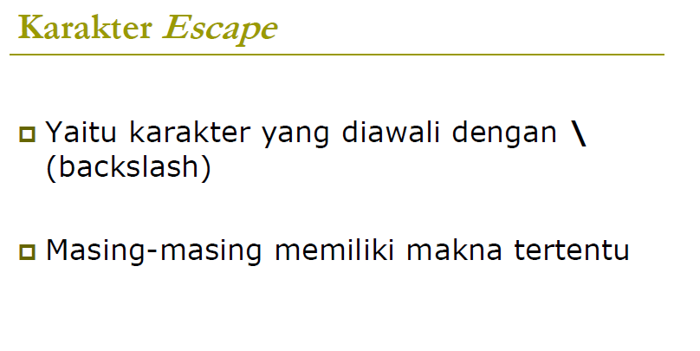
Notes:
Give a brief overview of the presentation. Describe the major focus of the presentation and why it is important.
Introduce each of the major topics.
To provide a road map for the audience, you can repeat this Overview slide throughout the presentation, highlighting the particular topic you will discuss next.

Slide 9
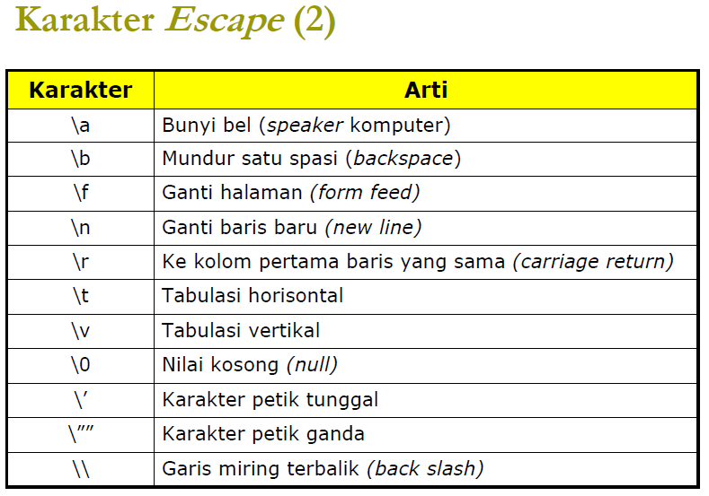
Notes:
Give a brief overview of the presentation. Describe the major focus of the presentation and why it is important.
Introduce each of the major topics.
To provide a road map for the audience, you can repeat this Overview slide throughout the presentation, highlighting the particular topic you will discuss next.

Slide 10
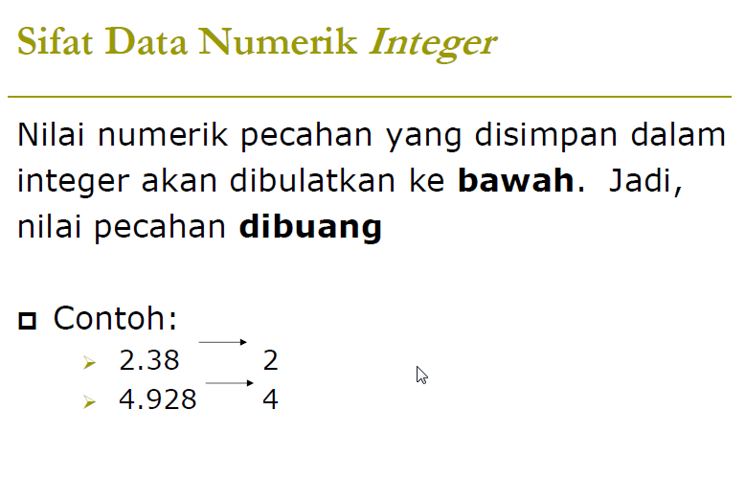
Notes:
Give a brief overview of the presentation. Describe the major focus of the presentation and why it is important.
Introduce each of the major topics.
To provide a road map for the audience, you can repeat this Overview slide throughout the presentation, highlighting the particular topic you will discuss next.

Slide 11
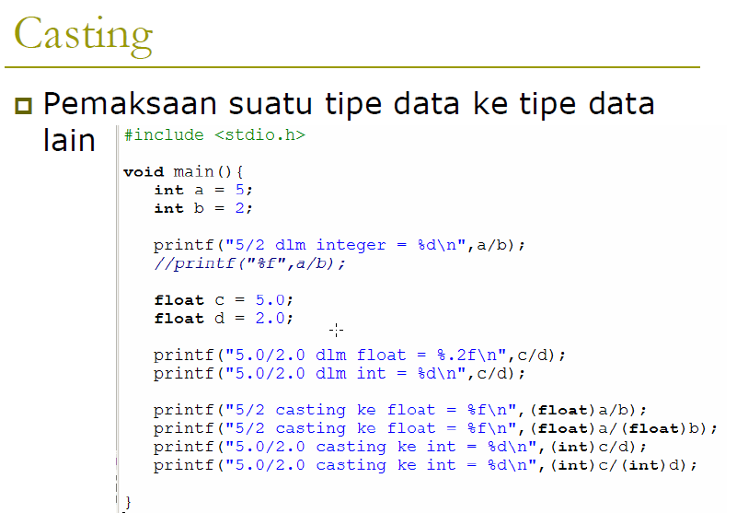
Notes:
Give a brief overview of the presentation. Describe the major focus of the presentation and why it is important.
Introduce each of the major topics.
To provide a road map for the audience, you can repeat this Overview slide throughout the presentation, highlighting the particular topic you will discuss next.

Slide 12
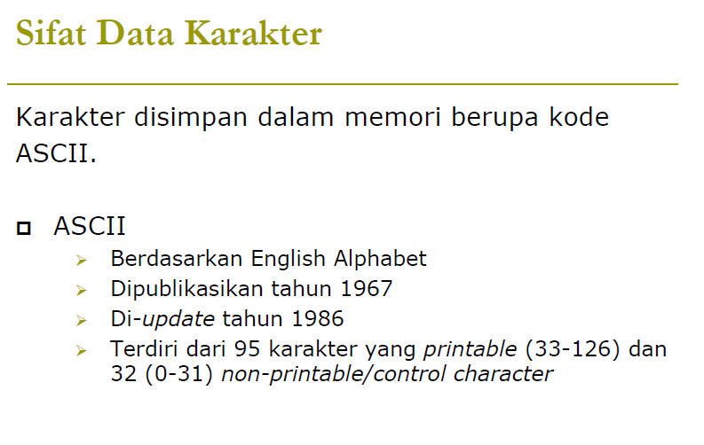
Notes:
Give a brief overview of the presentation. Describe the major focus of the presentation and why it is important.
Introduce each of the major topics.
To provide a road map for the audience, you can repeat this Overview slide throughout the presentation, highlighting the particular topic you will discuss next.

Slide 13
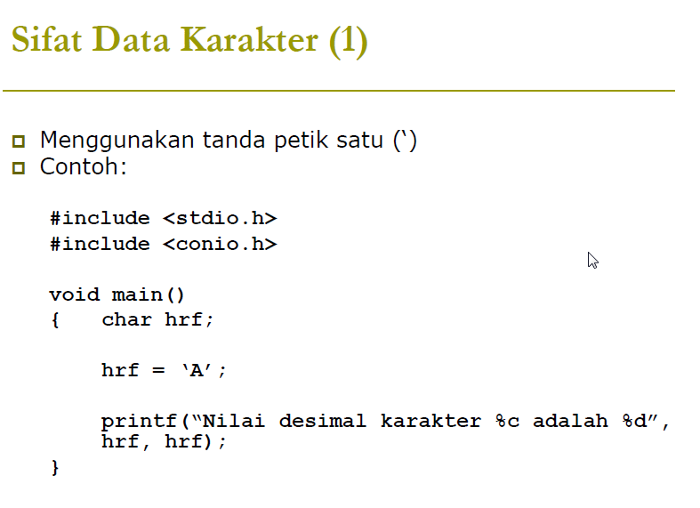
Notes:
Give a brief overview of the presentation. Describe the major focus of the presentation and why it is important.
Introduce each of the major topics.
To provide a road map for the audience, you can repeat this Overview slide throughout the presentation, highlighting the particular topic you will discuss next.

Slide 14

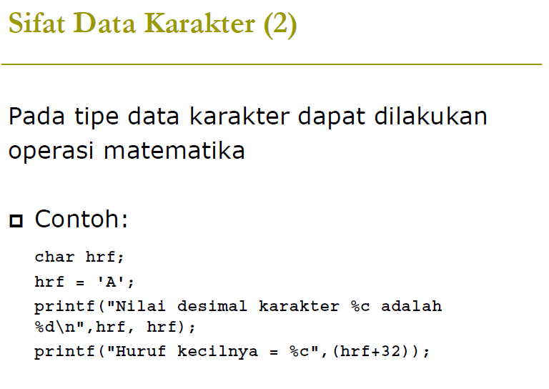
Notes:
This is another option for an Overview slides using transitions.

Slide 15
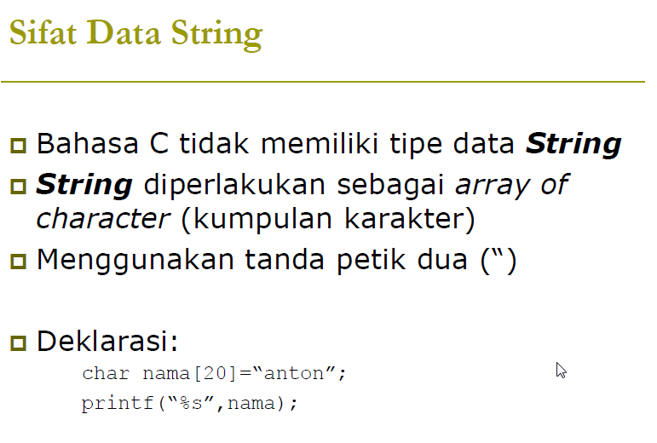
Notes:
This is another option for an Overview slides using transitions.

Slide 16
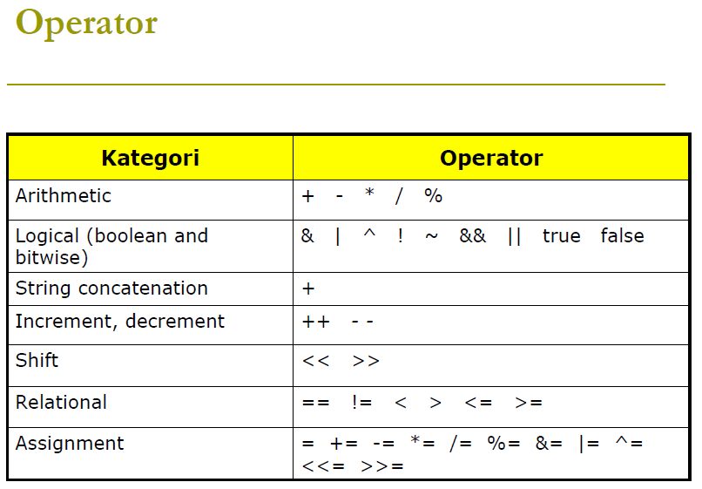
Notes:
This is another option for an Overview slides using transitions.

Slide 17
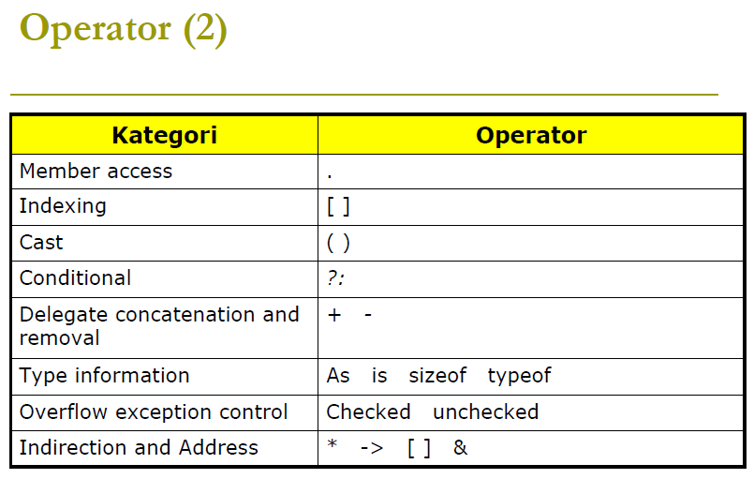

Slide 18
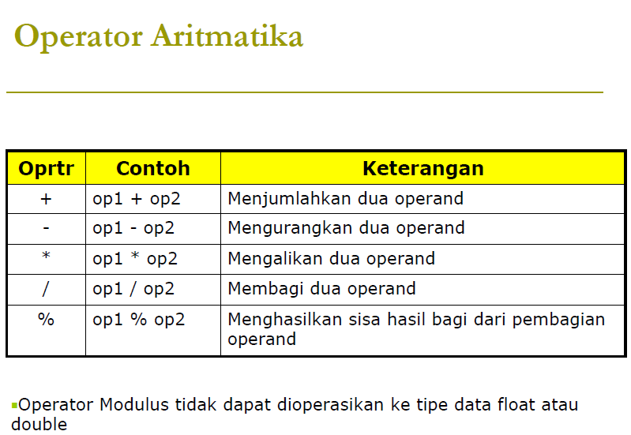


Slide 19

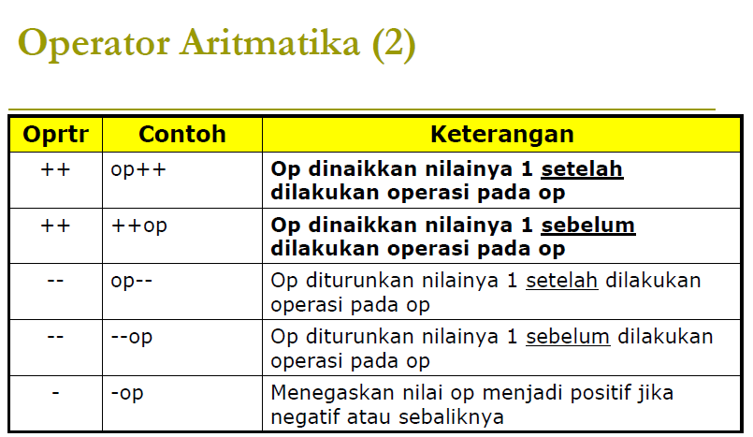

Slide 20
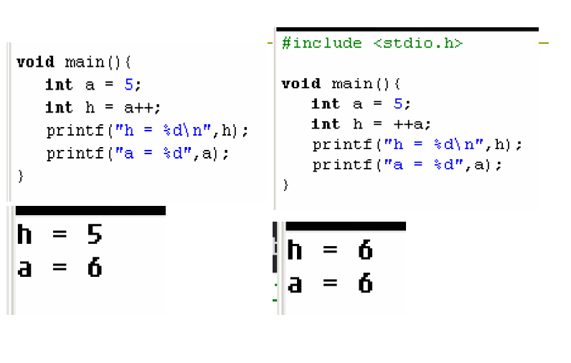
Notes:
What will the audience be able to do after this training is complete? Briefly describe each objective how the audience will benefit from this presentation.

Slide 21
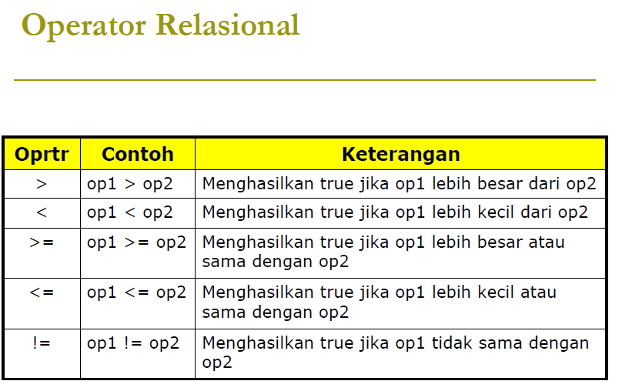
Notes:
What will the audience be able to do after this training is complete? Briefly describe each objective how the audience will benefit from this presentation.

Slide 22
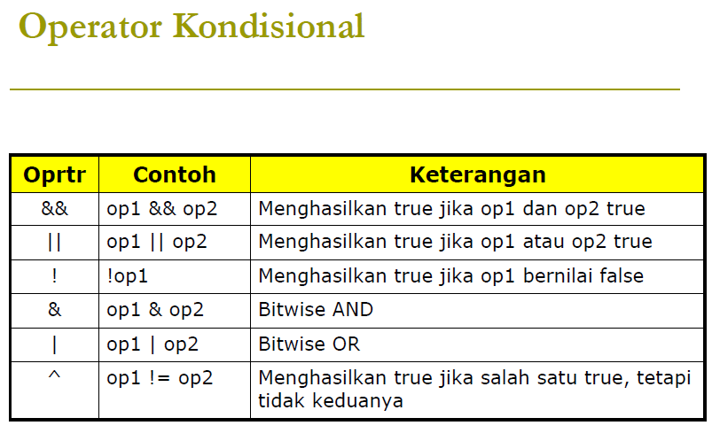

Slide 23
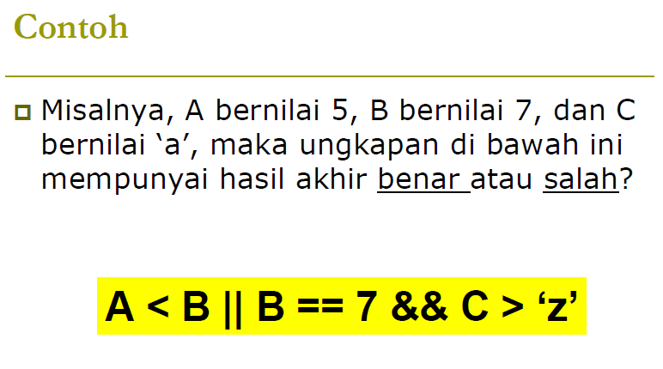

Slide 24
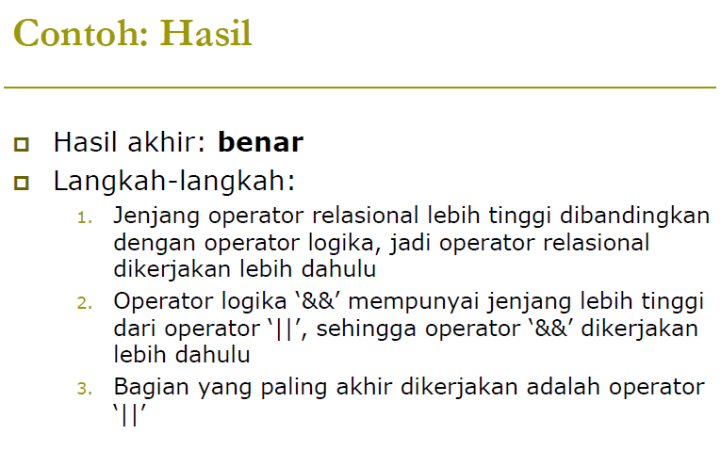

Slide 25
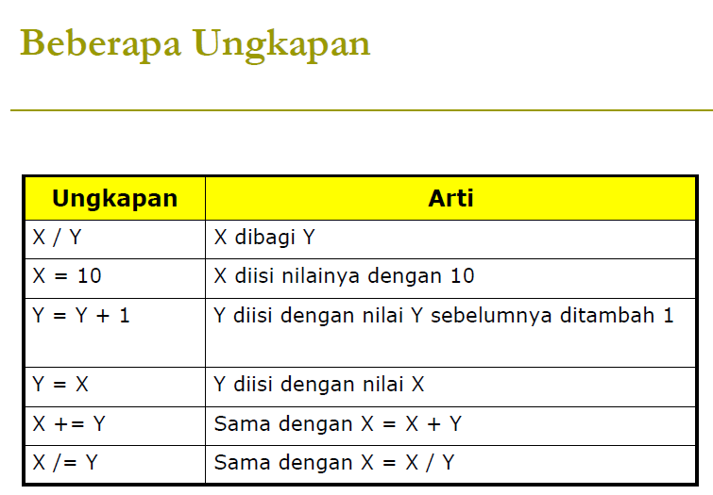

Slide 26
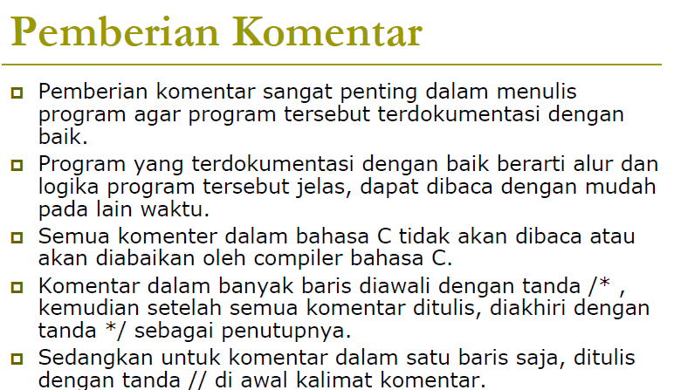

Slide 27


Slide 28
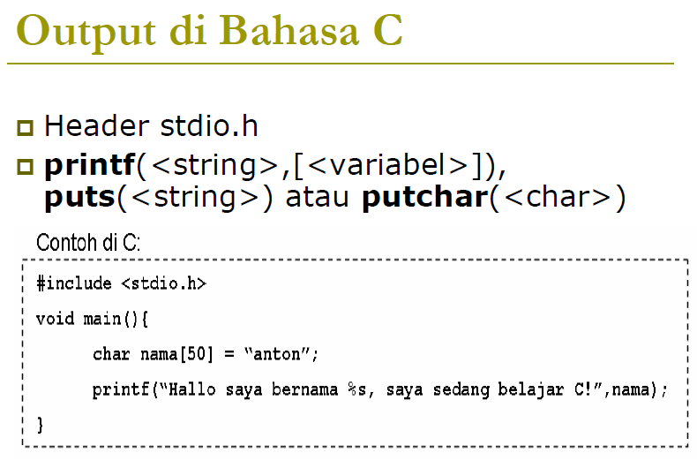

Slide 29
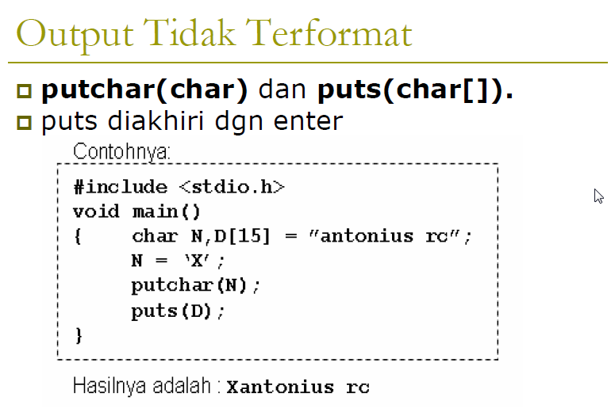

Slide 30
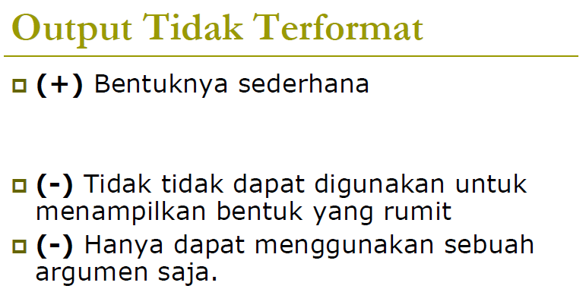

Slide 31
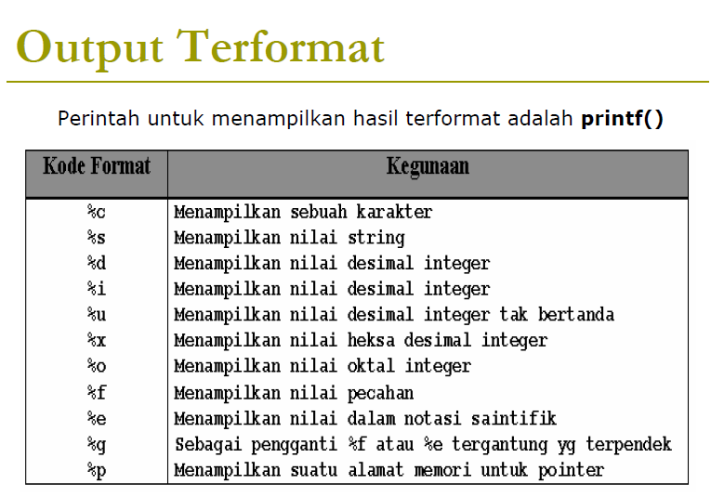

Slide 32
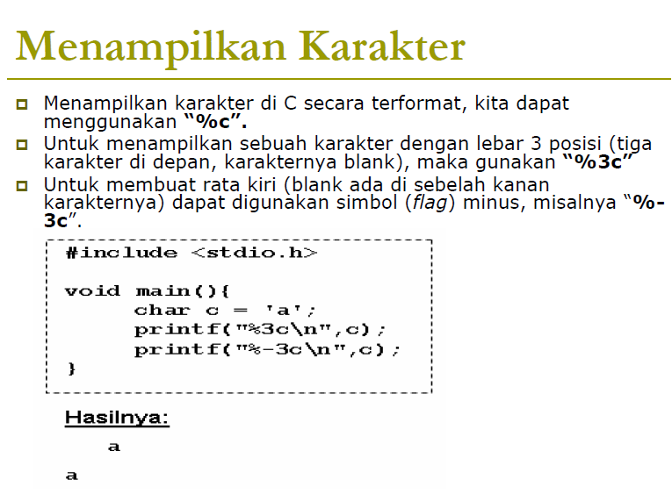

Slide 33
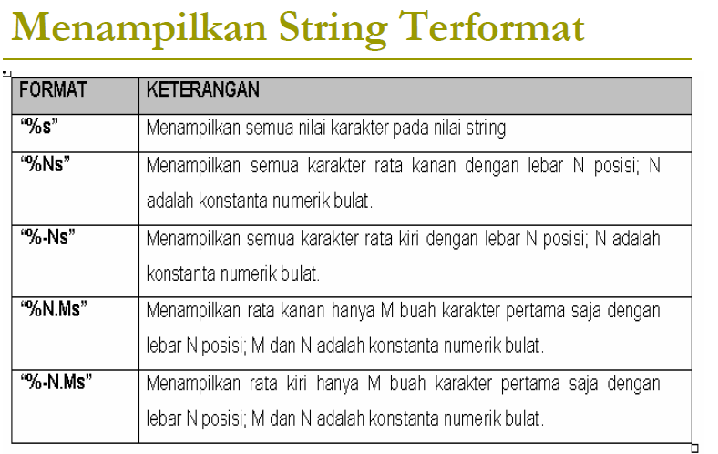

Slide 34
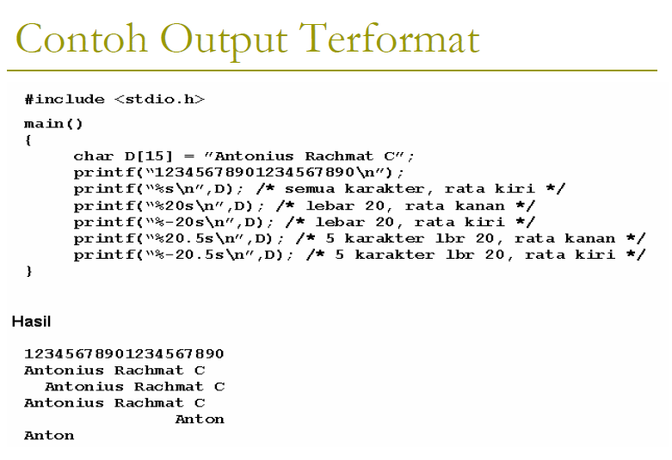

Slide 35
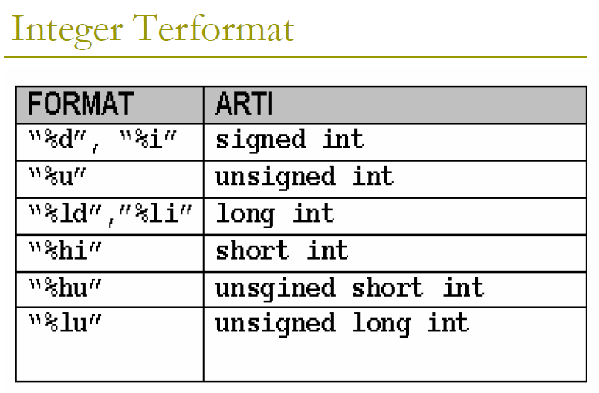

Slide 36
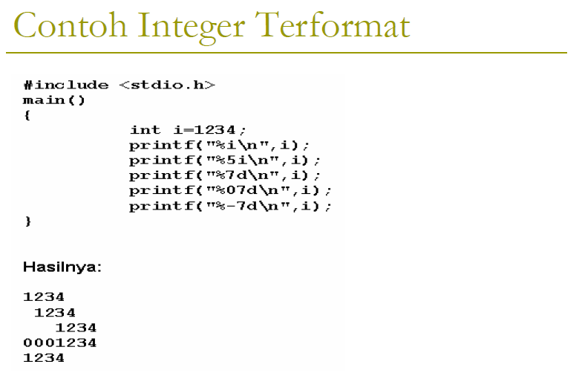

Slide 37
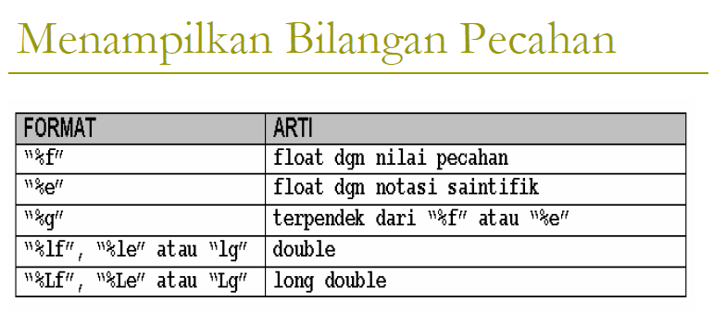

Slide 38
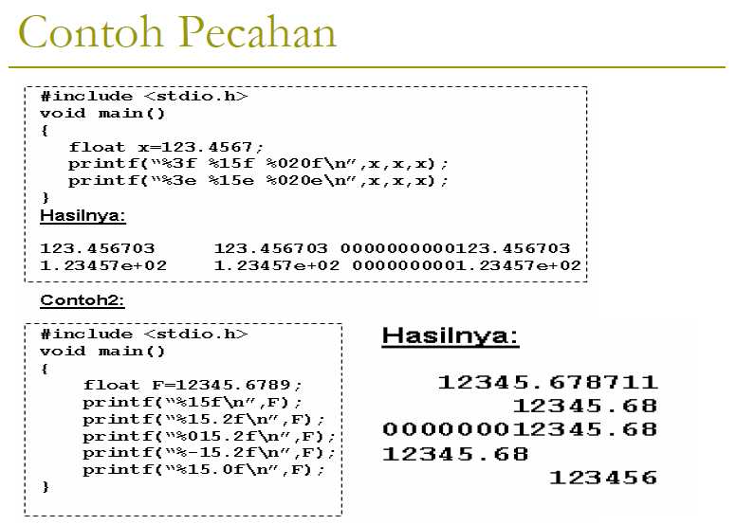

Slide 39
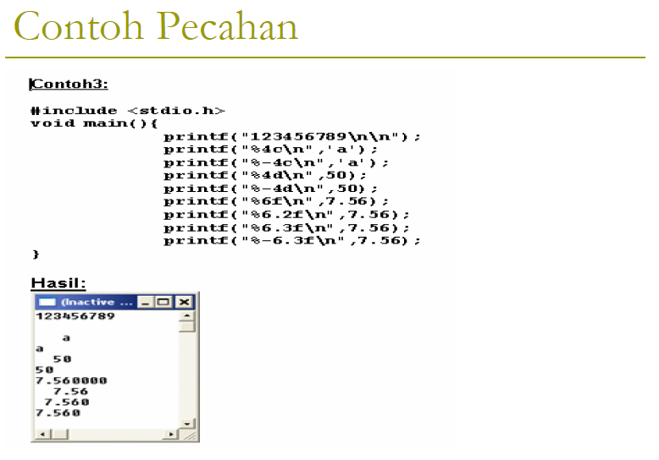

Slide 40
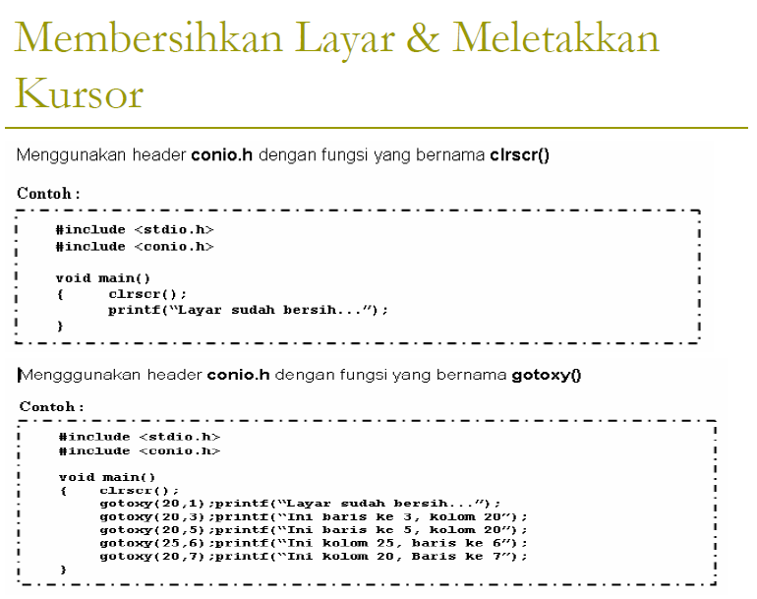

Slide 41
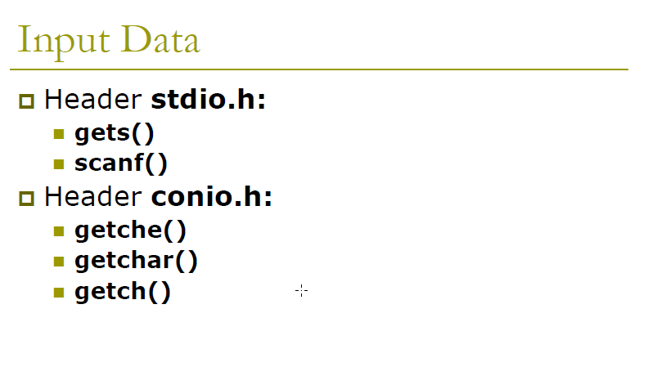

Slide 42
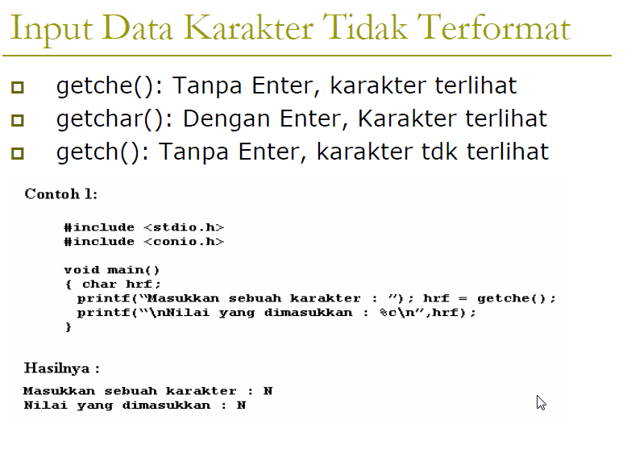

Slide 43
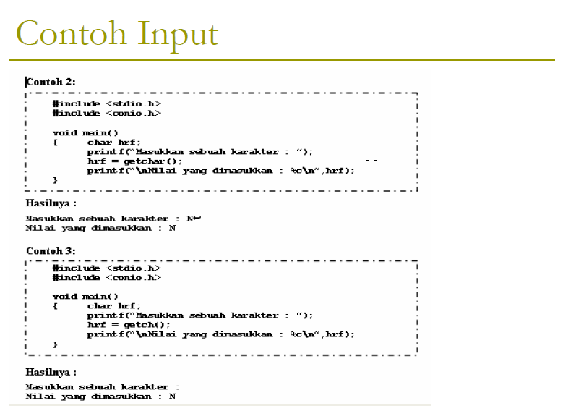

Slide 44
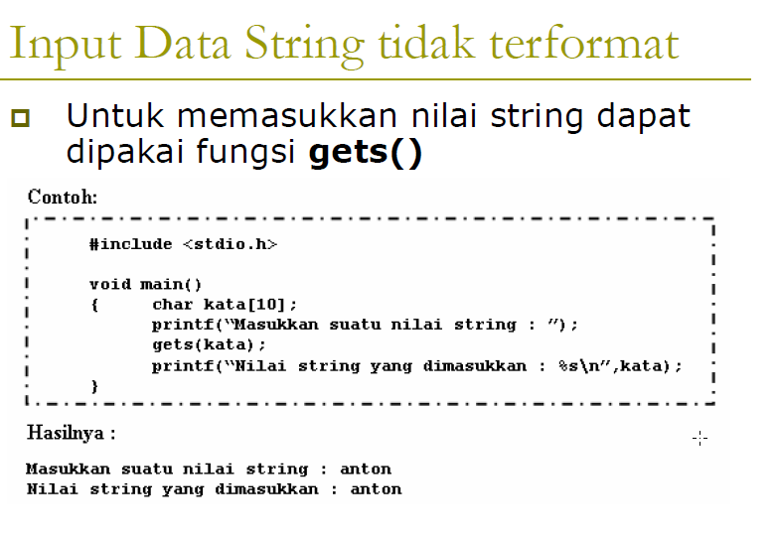

Slide 45
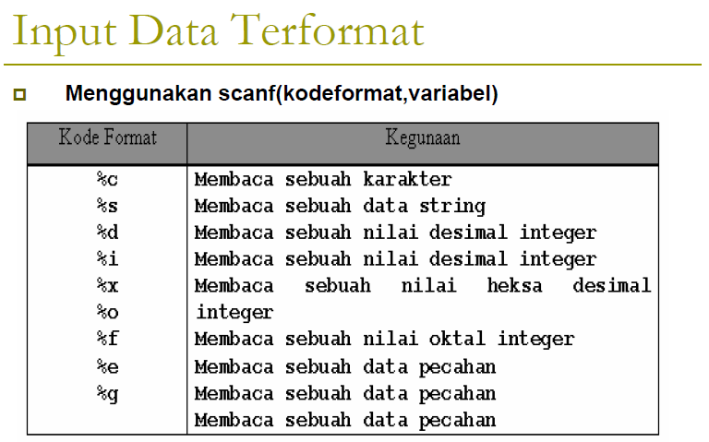

Slide 46
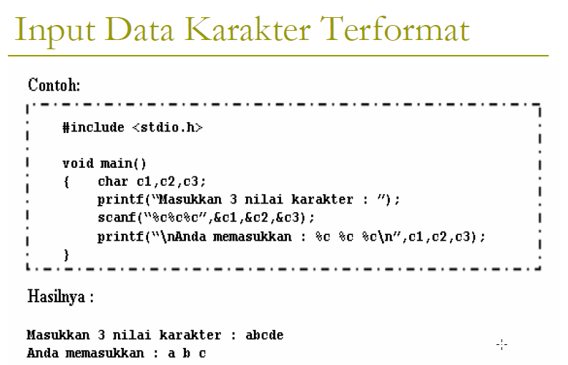

Slide 47
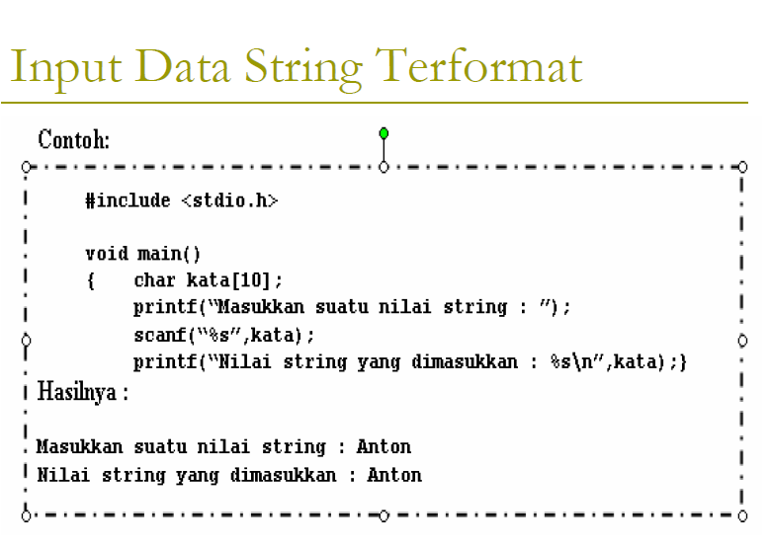

Slide 48
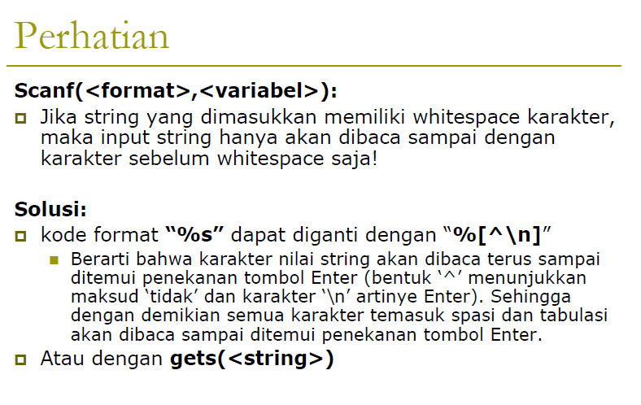

Slide 49
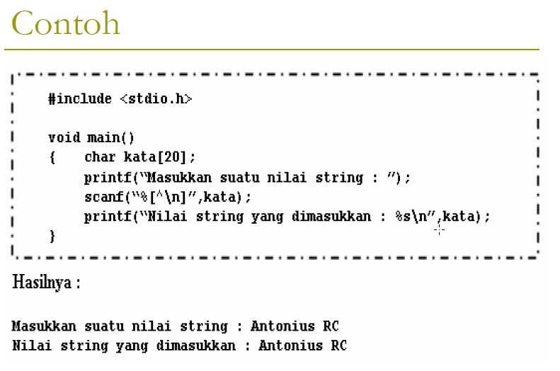

Slide 50
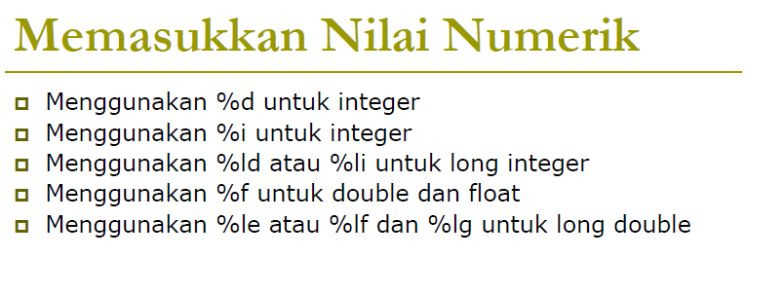

Slide 51
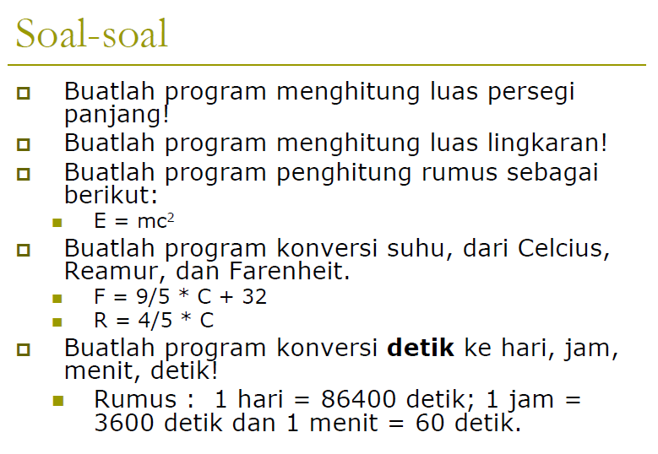

Slide 52
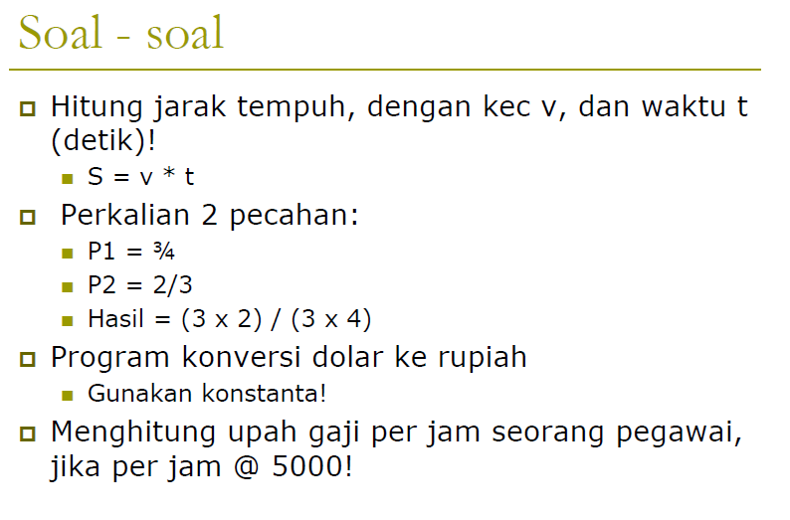

Slide 53
Terima Kasih
Notes:
Is your presentation as crisp as possible? Consider moving extra content to the appendix.
Use appendix slides to store content that you might want to refer to during the Question slide or that may be useful for attendees to investigate deeper in the future.

